Slide 1
Transport Layer

Slide 2
The TCP Segment Header

Slide 3
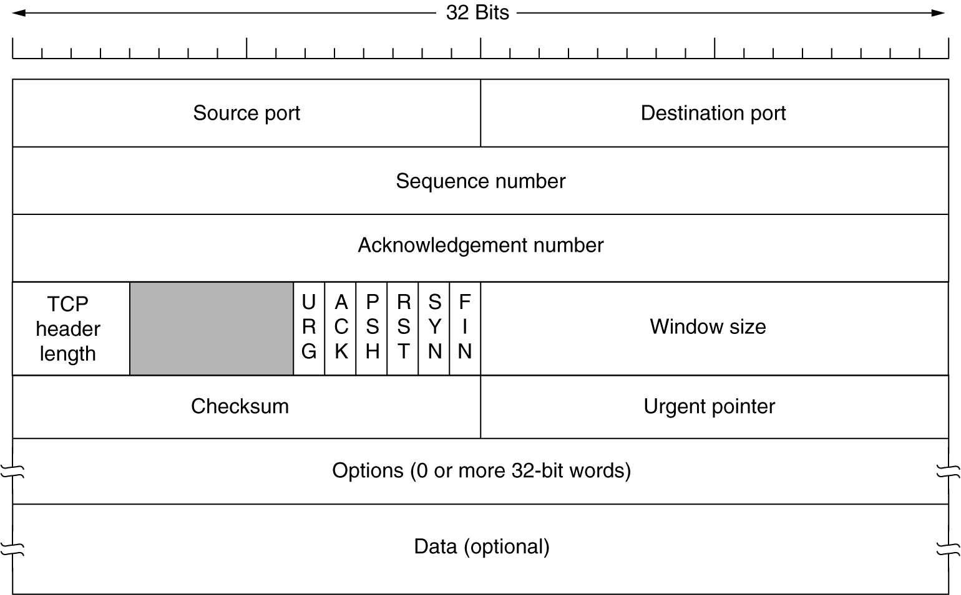
The TCP Segment Header

Slide 4
The TCP Segment Header
source and destination port numbers, that are used for multiplexing/demultiplexing data from/to upper layer applications.
sequence number field, and acknowledgment number field are used by the TCP sender and receiver in implementing a reliable data transfer service

Slide 5
The TCP Segment Header
The 4-bit length field specifies the length of the TCP header in 32-bit words (typically 20 bytes.)
The 16-bit window size field is used for the purposes of flow control
A Checksum is also provided for extra reliability.

Slide 6
The TCP Segment Header
The flag field contains 6 bits.
ACK → indicates that the value carried in the acknowledgment field is valid.
RST(reset) , SYN (Synchronize) ,FIN (Finish)
bits are used for connection setup and termination,
PSH(push)
indication that the receiver should pass the data to the upper layer immediately.
URG(urgent) → indicates there is data in this segment that the sending-side upper layer entity has marked as ``urgent.''

Slide 7
The TCP Segment Header
urgent data pointer
The location of the last byte of urgent data is indicated by the 16- bit urgent data pointer.
TCP must inform the receiving-side upper layer entity when urgent data exists and pass it a pointer to the end of the urgent data.

Slide 8
The TCP Segment Header
options field
The optional and variable length options field is used when a sender and receiver negotiate the maximum segment size.

Slide 9
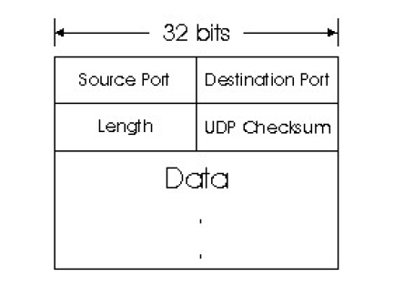
UDP Segment Structure
All fields are similar to TCP segment header fields

Slide 10
TCP Connection Management

Slide 11

TCP Connection Management
Suppose a process running in one host wants to initiate a connection with another process in another host.
The host that is initiating the connection is called the client host. the other host is called the server host

Slide 12
TCP Connection Management
The client application process first informs the client TCP that it wants to establish a connection to a process in the server.
The TCP in the client then proceeds to establish a TCP connection with the TCP in the server in the following manner

Slide 13
TCP Connection Management
Step 1 : The client-side TCP first sends a special TCP segment to the server-side TCP.
Client sets SYN bit to 1
Client chooses an initial sequence number (client_isn) and puts this number in the sequence number field
(see the TCP segment header)
This segment is encapsulated within an IP datagram and sent into the Internet

Slide 14
TCP Connection Management
Step 2 : when the IP datagram containing the TCP segment arrives at the server host
The server extracts the TCP segment from the datagram
Allocates the TCP buffers and variables to the connection
sends a connection-granted segment to client TCP.

Slide 15
TCP Connection Management
Step 2 :
In connection-granted TCP segment
the SYN bit is set to 1.
the acknowledgment field of the TCP segment header is set to isn+1.
Finally, the server chooses its own initial sequence number (server_isn) and puts this value in the sequence number field of the TCP segment header.

Slide 16
TCP Connection Management
Step 3.: Upon receiving the connection-granted segment
the client also allocates buffers and variables to the connection
The client host then sends the server yet another segment to acknowledge the server's connection-granted segment. (by putting server_isn+1 in the acknowledgment field of the TCP segment header)
The SYN bit is set to 0, since the connection is established

Slide 17
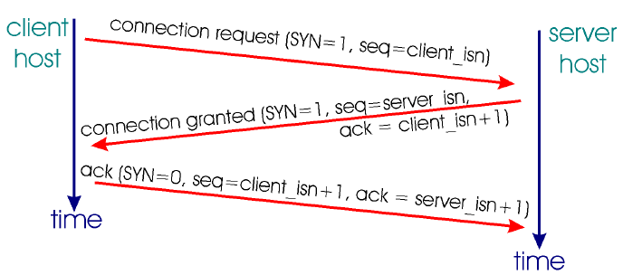
TCP Connection Management

Slide 18
Multiplexing and Demultiplexing

Slide 19
Multiplexing and Demultiplexing
Each transport-layer segment has a field that contains information that is used to determine the process to which the segment's data is to be delivered.
Multiplexing :
Gathering data at the source host from different application processes, enveloping the data with header information to create segments, and passing the segments to the network layer is called multiplexing.

Slide 20
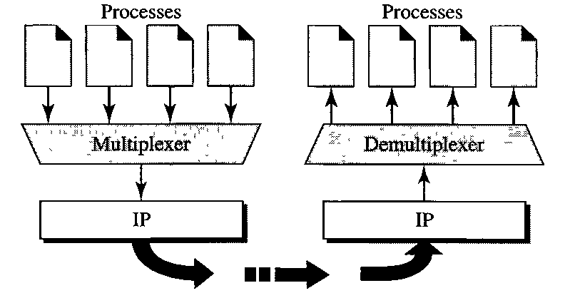
Multiplexing and Demultiplexing
Demultiplexing :
delivering the data in a transport-layer segment to the correct application process is called demultiplexing
Transport Layer →
Network Layer →

Slide 21
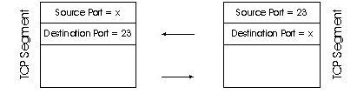
Multiplexing and Demultiplexing
UDP and TCP perform the demultiplexing and multiplexing jobs by using the following fields in the segment headers:
the source port number field
destination port number field.
The fields uniquely identify an application process running on the destination host

Slide 22
Multiplexing and Demultiplexing
2 types of multiplexing
Upward multiplexing
Downward multiplexing

Slide 23
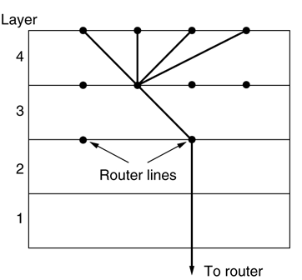
Upward multiplexing
It occurs when multiple higher-level connections are multiplexed on, or share, a single lower-level connection.
For example, if only one network address is available on a host, all transport connections on that machine have to use it.

Slide 24
Upward multiplexing
makes more efficient use of the lower-level service to
provides several higher-level connections in an environment where only a single lower-level connection exists.

Slide 25
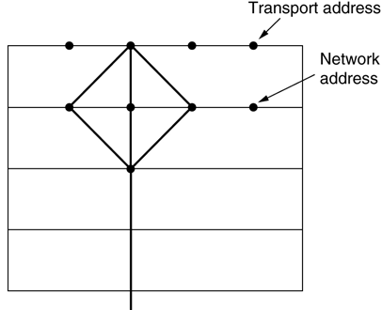
Downward multiplexing
Downward multiplexing is the splitting of a single higher level connection among multiple lower-level connections.

Slide 26
Downward multiplexing
the traffic on the higher connection is divided among the various lower connections.
This technique may be used to provide reliability, performance, or efficiency.

Slide 27
Downward multiplexing
the traffic on the higher connection is divided among the various lower connections.
This technique may be used to provide reliability, performance, or efficiency.

Slide 28
Crash Recovery

Slide 29
Crash Recovery
When the server upon which a transport entity is running fails and subsequently restarts, the state information of all active connections is lost.
The server might send a broadcast TPDU to all clients, requesting them to inform it of the status of all open connections

Slide 30
Crash Recovery
Now each client can be in one of two states:
one TPDU outstanding. This state is S1,
No TPDUs outstanding, This state is S0.
Based on only this state information, the client must decide whether to retransmit the most recent TPDU

Slide 31
Crash Recovery
Now consider the following two cases:
Case 1:
The server first sends an acknowledgement
Crashes before it writes TPDU to the application process
In this case the client will receive the acknowledgement and so it will not retransmit the TPDU.

Slide 32
Crash Recovery
Case 2:
The server first writes TPDU to the application process
Crashes before it sends an acknowledgement
In this case the client will not receive the acknowledgement and so it will retransmit the TPDU.

Slide 33
Crash Recovery
We notice the following in the cases:
In the first case the client thinks that TPDU is has been delivered, but it is actually lost.
In the second case the client thinks that TPDU is has not been delivered, it resends. So duplicate TPDU will arrive at the server.

Slide 34
Crash Recovery
So three events are possible at the server:
sending an acknowledgement (A),
writing to the output process (W),
crashing (C).
Three events can occur in six different orderings:
AC(W), AWC, C(AW), C(WA), WAC, and WC(A)
where the parentheses are used to indicate that neither A nor W can follow C

Slide 35
Crash Recovery
The client can be programmed in one of four ways:
Always retransmit the last TPDU,
never retransmit the last TPDU,
retransmit only in state S0,
retransmit only in state S1

Slide 36
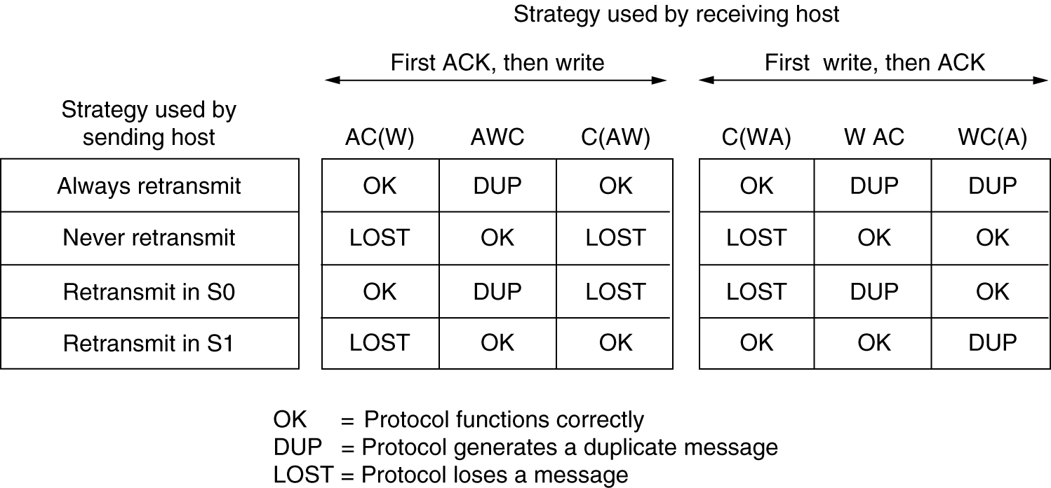
Crash Recovery
Figure shows all eight combinations of client and server strategy and the valid event sequences for each one. Notice that for each strategy there is some sequence of events that causes the protocol to fail

Slide 37
Crash Recovery
The conclusion is inescapable:
“under our ground rules of no simultaneous events, host crash and recovery cannot be made transparent to higher layers.”

Slide 38
The Real-Time Transport Protocol (RTP)

Slide 39
RTP
RTP is the protocol designed to handle real-time traffic on the Internet
Can transport common formats such as WAV or GSM for sound and MPEG1 and MPEG2 for video.
It can also be used for transporting proprietary sound and video formats.

Slide 40
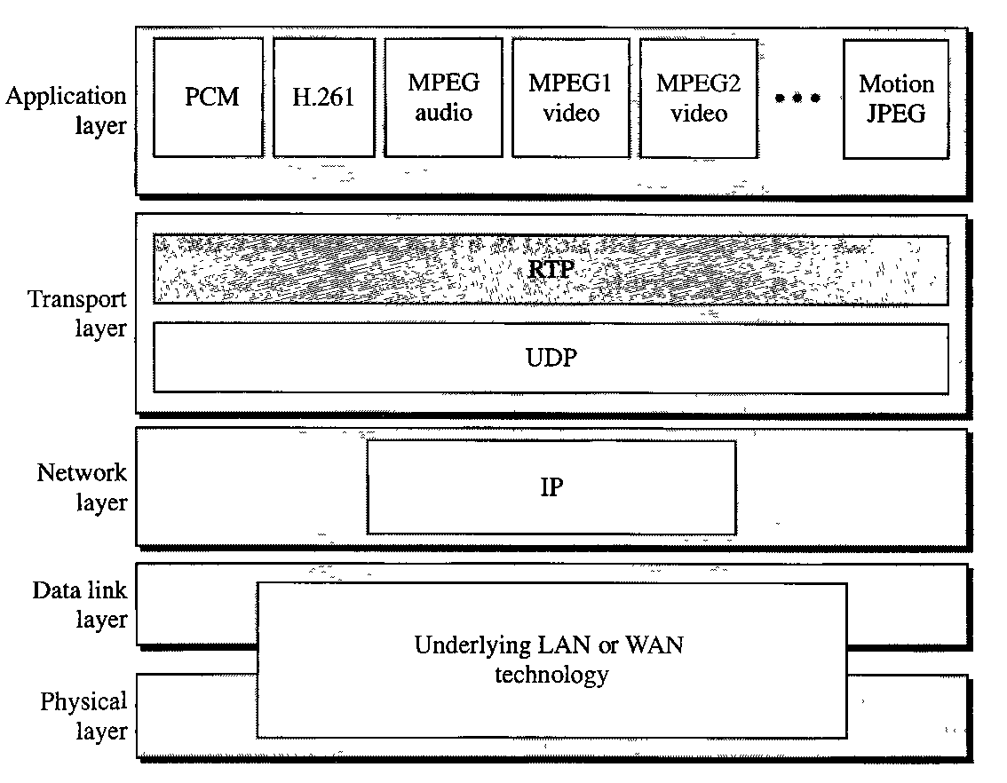
RTP
RTP stands between UDP and the application program .
RTP can be viewed as a sublayer of the transport layer
( Because RTP provides services to the multimedia applications)

Slide 41
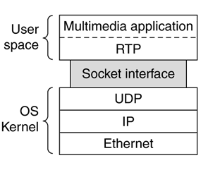
RTP
From the application developer's perspective, however, RTP is part of the application layer.
This is because the developer must integrate RTP into the application.

Slide 42
RTP
RTP works as follows (refer the previous slide figure):
Sending multimedia application, creates RTP packets
(RTP packet contains RTP header + multimedia data)
the application then sends the RTP packets into a UDP socket interface
At receiver side the RTP packets enter the application through a UDP socket interface.
Receiver application extracts the media chunks from the RTP packets.

Slide 43
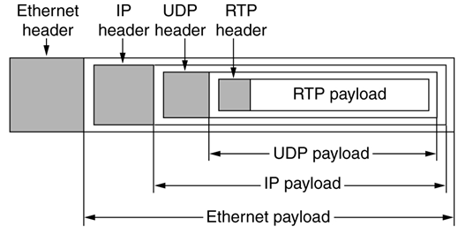
RTP
Specifically, audio or video chunks of data, generated by the sending side of a multimedia application, are encapsulated in RTP packets, and each RTP packet is in turn encapsulated in a UDP segment

Slide 44
RTP features
The basic function of RTP is to multiplex several real-time data streams onto a single stream of UDP packets
RTP has no flow control, no error control, no acknowledgements, and no mechanism to request retransmissions.
provides for interoperability
Allows each RTP payload to contain multiple samples
For example, a single audio stream may be encoded as 8-bit PCM samples at 8 kHz, delta encoding, predictive encoding, GSM encoding, MP3, and so on

Slide 45
RTP features
Each RTP has sequence number to indicate packet loss
( This will enable the destination to approximate the missing values)
synchronization of multiple media
[e.g. synchronizing an audio and video stream that are originating from the same sender.]

Slide 46
RTP features
An important feature of RTP is timestamping
The timestamp value in the packet is a number representing the time at which the first sample in the packet was generated
timestamping enables the receiver to buffer samples and play them back at the appropriate time.

Slide 47
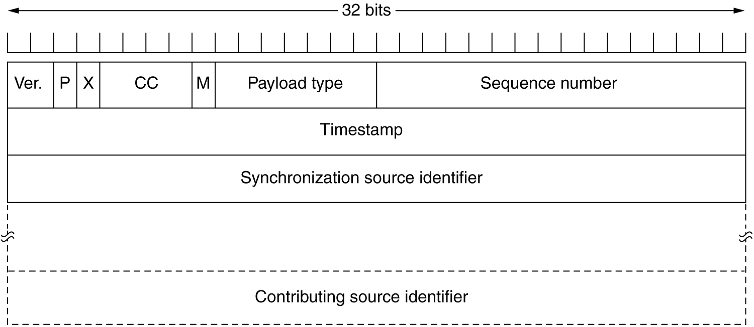

RTP Packet Format

Slide 48
RTP Packet Format
The P bit indicates that the packet has been padded to a multiple of 4 bytes. The last padding byte tells how many bytes were added
The X bit indicates that an extension header is present.
The CC (Contributor count) field tells how many contributing sources are present, from 0 to 15.
The M bit is an application-specific marker bit . It can be used to mark the start of a video frame, the start of a word in an audio channel

Slide 49
RTP Packet Format
The Payload type field tells which encoding algorithm has been used (e.g., uncompressed 8-bit audio, MP3, etc.).
The Sequence number is just a counter that is incremented on each RTP packet sent. It is used to detect lost packets.
The timestamp is produced by the stream's source to note when the first sample in the packet was made

Slide 50
RTP Packet Format
The Payload type field tells which encoding algorithm has been used (e.g., uncompressed 8-bit audio, MP3, etc.).
The Sequence number is just a counter that is incremented on each RTP packet sent. It is used to detect lost packets.
The timestamp is produced by the stream's source to note when the first sample in the packet was made
[receiver can use the timestamps in order to remove packet jitter introduced in the network and to provide synchronous playout at the receiver.]

Slide 51
RTP Packet Format
The Synchronization source identifier tells which stream the packet belongs to.
The contributing source (CSRC) is used only when a number of RTP streams pass through a “mixer.”
A mixer can be used to reduce the bandwidth requirements for a conference by receiving data from many sources and sending it as a single stream.

